Slide 1

MCS 7103 MACHINE LEARNING ANALYSIS AND PREDICTION FOR BIKE HIRING(SHARING) IN SEOUL
UCI Machine Learning Repository
https://archive.ics.uci.edu › datasets › Seoul+Bike+Sharing...
Ndibalekera Rhoda Diana 2024/HD05/21951U
Nuwasiima Brenda 2024/HD05/21941U

Slide 2

BACKGROUND
There is a rise in urbanization in many cities across the world which has resulted in extreme congestion, pollution, high cost of living and environmental concerns. This has prompted many to seek sustainable transportation solutions to reduce traffic, lower carbon emissions, and improve public health.
Bike hiring has been successfully implemented in cities like Amsterdam, Paris, Copenhagen, Seoul, New York City, San Francisco, London, Barcelona, Montreal, and Melbourne. In Kampala, Makerere university in partnership with Star Digital Bikes introduced bicycles to ease movement on the hill and promote exercise while sustaining the environment. [1]
A deeper understanding of the bike-sharing market will offer action points and recommendations for government, policymakers and entrepreneurs and to improve city life.

Slide 3
Introduction
This dataset contains a count of public bicycles rented per hour in the Seoul Bike Sharing System, with corresponding weather data and holiday information.
The Seoul Bike Sharing Demand dataset covers 12 months of data from December 1, 2017, to November 30, 2018, and was obtained from the UC Irvine machine learning data repository website.
This report will show the data analysis carried out on the above data set, attempts to predict the hourly rental demand for public bikes using the Seoul Bike Sharing System by evaluating various machine learning regression models namely Linear Regression, Decision Tree Regression, Random Forest Regression.
EXPECTED OUTPUTS
Data Analysis
Visual Representation
Prediction Models
Conclusion

Slide 4
PROBLEM STATEMENT
OBJECTIVE
Despite the availability of this data, accurately predicting the hourly demand for bike rentals remains a challenge. This prediction is crucial for optimizing bike distribution, managing inventory, and enhancing user satisfaction.
To develop and refine regression models to predict the hourly rental demand for public bikes in Seoul, aiming to enhance operational efficiency and support sustainable transportation initiatives.

Slide 5
SCOPE
Identifying and leveraging key features that influence bike rental demand, such as weather conditions, time of day, and holidays.
Handling data preprocessing tasks like normalization, outlier treatment, and feature selection to ensure high-quality inputs for the models.
Selecting and tuning appropriate machine learning regression models to predict hourly bike rental counts accurately.
Integrating additional relevant data sources and exploring advanced modelling techniques to improve predictive performance and provide actionable insights.

Slide 6
6. ⁠Methodology.
Dataset identification
Choose appropriate dataset
Exploratory data analysis
Clean and select relevant features.
Model selection
Choose regression models to train and test data.
Assess
Assess model performance
Explain Models
Use Lime and Shap to explain models

Slide 7
QUESTIONS
What is this data set about?
What are the attributes?
Is the data clean?
This dataset has 14 features (columns) and 8760 rows.
'Rented Bike Count' is the key attribute for this set.
The data does not have any null values or duplicated records.
The dataset contains weather information (Temperature, Humidity, Windspeed, Visibility, Dewpoint, Solar radiation, Snowfall, Rainfall), the number of bikes rented per hour and date information.

Slide 8
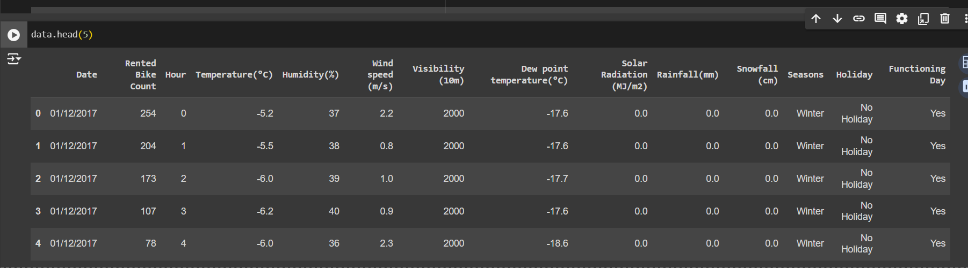
THE DATA SET
Data.info()
This data set has 8760 entries, 0 to 8759 and the following Columns.
Date 8760 non-null object
Rented Bike Count 8760 non-null int64
Hour 8760 non-null int64
Temperature(°C) 8760 non-null float64
Humidity(%) 8760 non-null int64
Wind speed (m/s) 8760 non-null float64
Dew point temperature(°C) 8760 non-null float64
Visibility (10m) 8760 non-null int64
Solar Radiation (MJ/m2) 8760 non-null float64
Rainfall(mm) 8760 non-null float64
Snowfall (cm) 8760 non-null float64
Seasons 8760 non-null object
Holiday 8760 non-null object
Functioning Day 8760 non-null object

Slide 9
DATA EXPLORATION
QUESTIONS
Which season has the most bike rentals?
In which month or day are most bike rentals?
How do weather conditions affect bike rental count?
Which attribute has the biggest effect on our variable?
How do the types of days or seasons affect bike rental count?

Slide 10
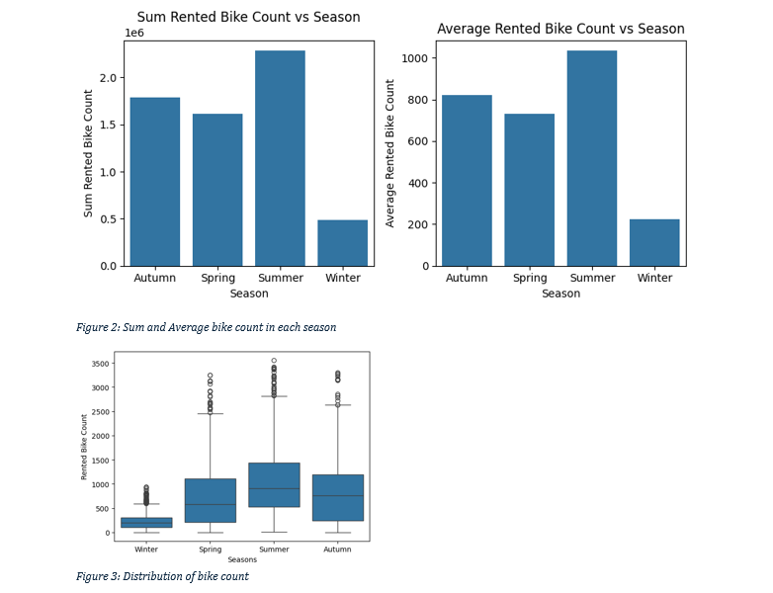
SEASONS
According to the graphs shown above, most bikes are rented in summer and most days range between 500 – 1500 per day. The lowest number is in winter with ranges less than 400 a day.

Slide 11
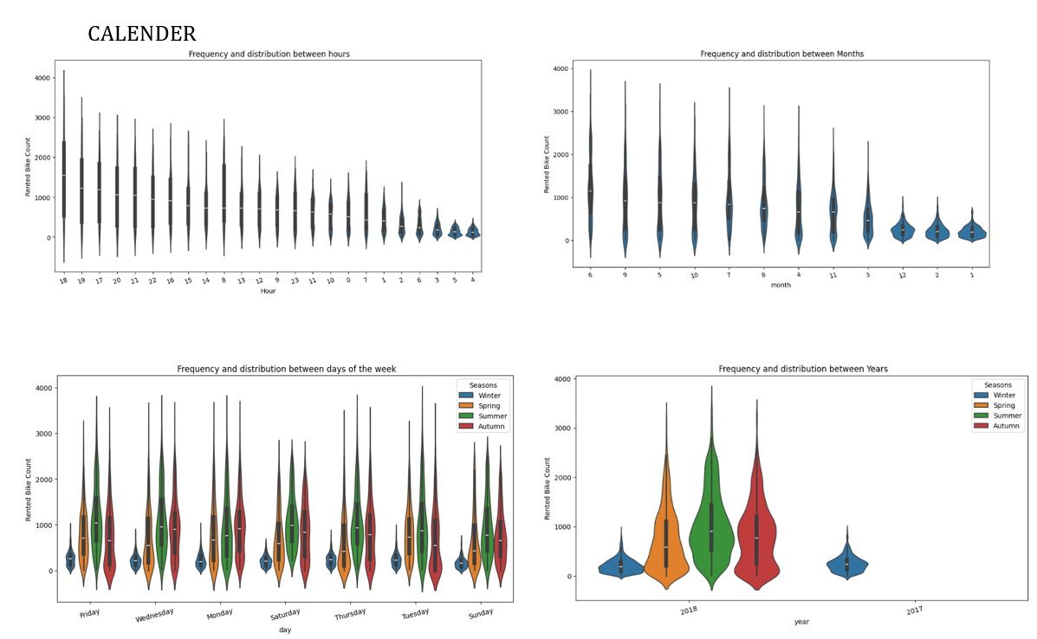
CALENDER ANALYSIS

Slide 12
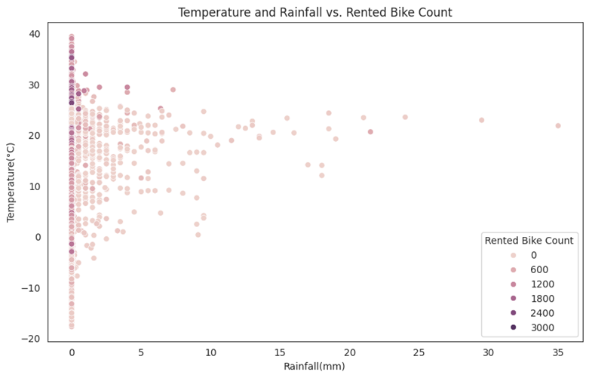
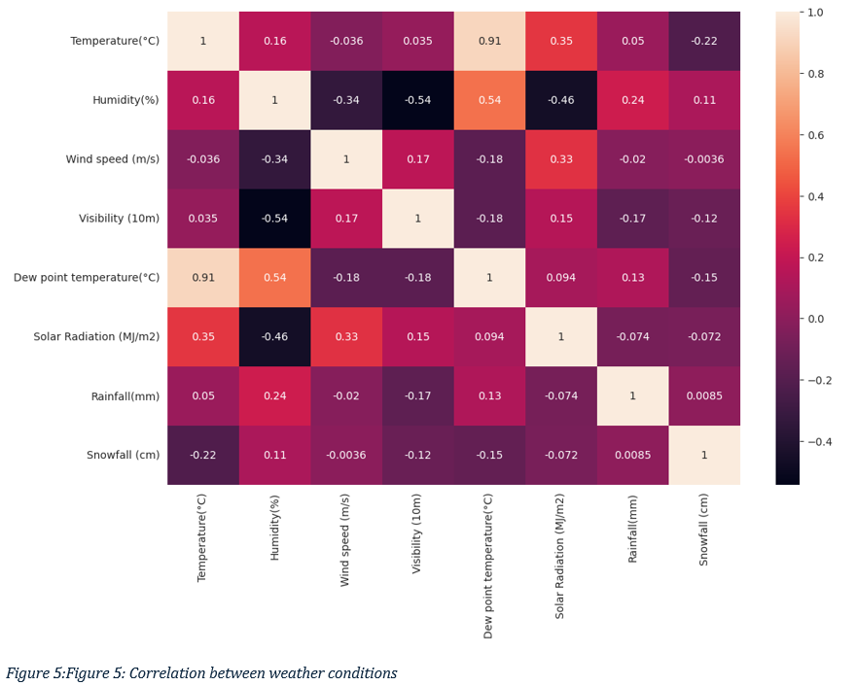
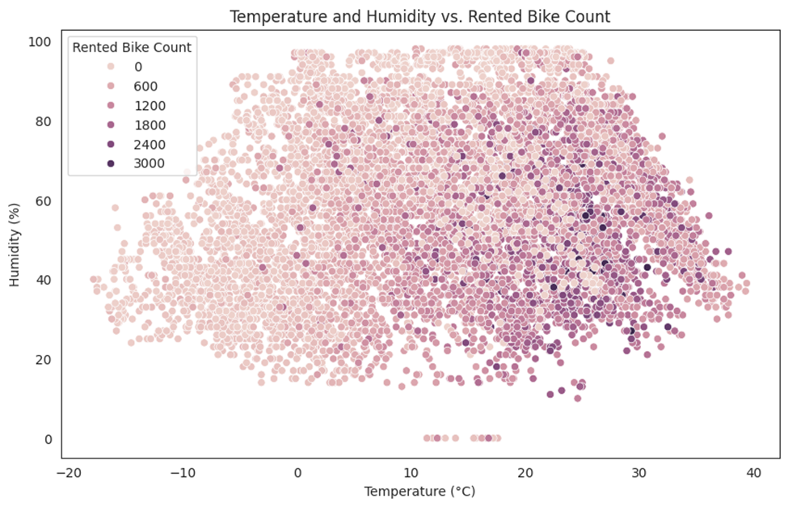
CORRELATION

Slide 13
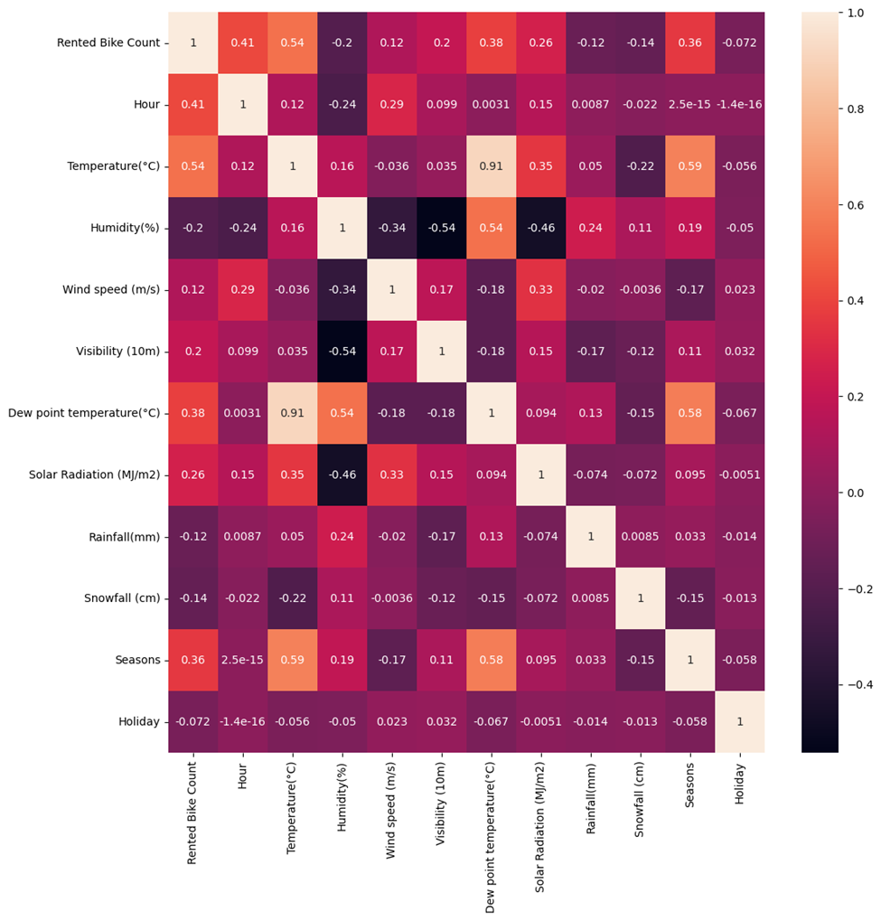
Rented Bike Count Vs All attributes
The heatmap indicates that weather conditions, particularly temperature, humidity, and wind speed, have a significant impact on the number of rented bikes.
The correlation between 'Rented Bike Count' and these weather parameters indicate that favorable weather conditions are associated with higher bike rental demand.
Temperature, hour of the day, dew point and season in the order are great determinant factors for bikes rented on a particular day

Slide 14
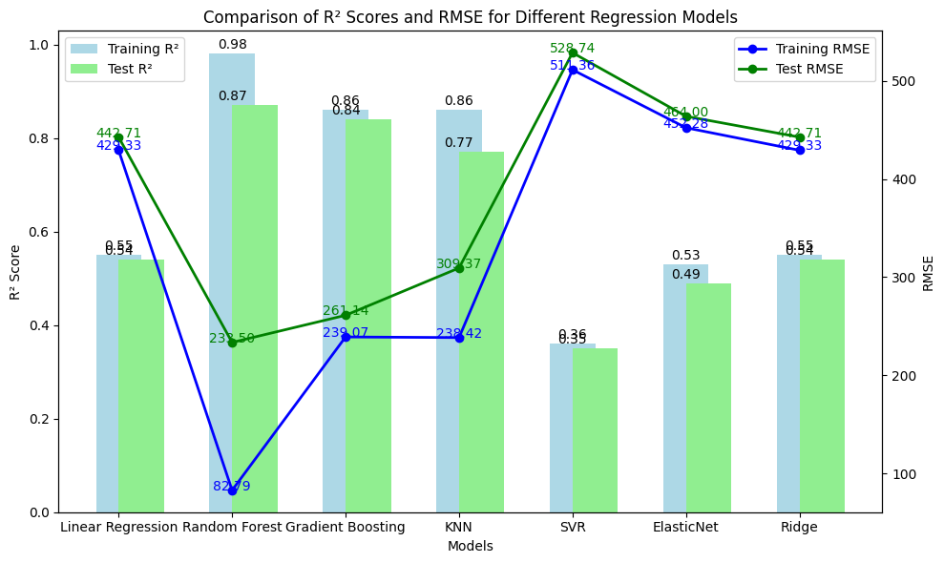
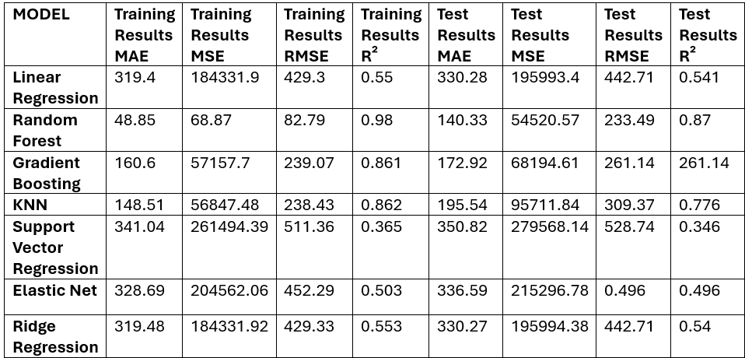
REGRESSION MODEL PERFORMANCE

Slide 15
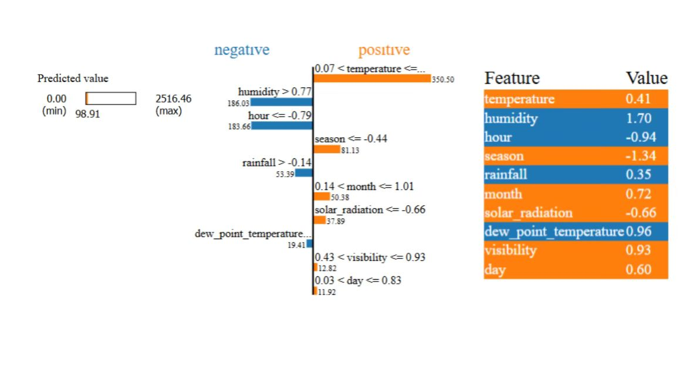
LIME
We aimed to predict the bike rental count (count) as a continuous variable, and the models' performances can be evaluated by comparing the predictions they make to the actual values, using metrics that quantify how close the predictions are. Our evaluations are based on RMSE (lower is better) and R² Score (higher is better).
Linear Regression:The linear regression model struggles to capture the nonlinear relationships in the data, as evidenced by the high RMSE and low R² score.
Random Forest:Random Forest performs well, reducing error significantly compared to Linear Regression and capturing most of the variance in the data.
Gradient Boosting:Gradient Boosting performs well but is slightly less accurate than Random Forest in this case.
XGBoost:XGBoost outperforms all other models for regression, providing the lowest error and the highest R² score.
Best Regression Model: XGBoost Regressor (lowest RMSE and highest R²).

Slide 16
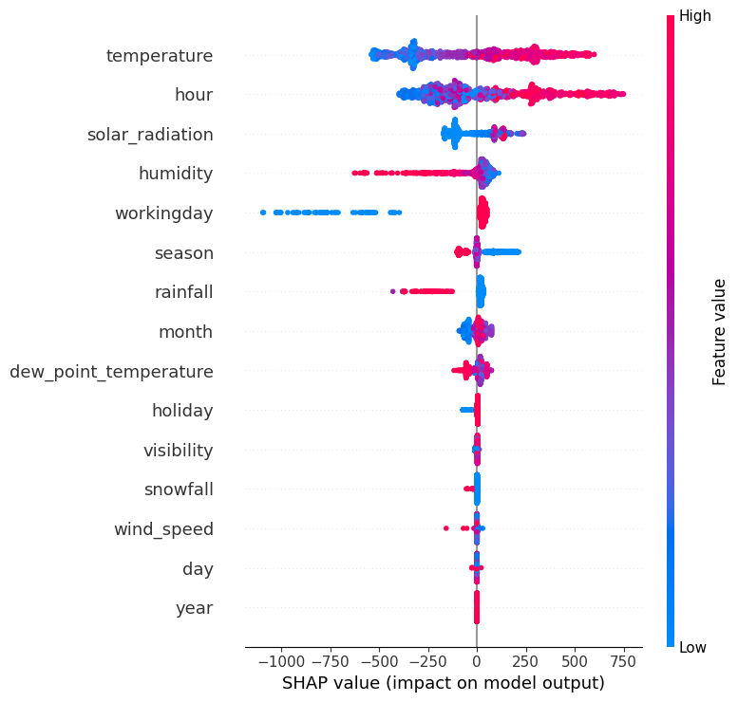
SHAP
This image is a SHAP (SHapley Additive exPlanations) summary plot that shows the impact of
different features on the model's output.
Color Gradient: Represents feature values, with blue: lower values and red :higher values for each feature.
SHAP Values (x-axis): The SHAP value indicates the influence of a feature on the model’s prediction. Positive SHAP values push the model's prediction higher, and negative SHAP values push it lower.
Observation: Temperature," "hour," and "solar radiation" have a larger impact on the model’s predictions.
Features like "wind_speed" and "year" have have a smaller influence.

